Slide 1

What’s new in the treatment of Myeloproliferative Neoplasms?
Vikas Gupta, MD, FRCP, FRCPath
The Elizabeth and Tony Comper MPN Program
Princess Margaret Cancer Centre
University of Toronto
Toronto, Canada

Slide 2
Disclosures
Vikas Gupta, MD, FRCP, FRCPath
Research support/P.I. | Novartis, Incyte, Gilead, Promedior,
Employee | None
Consultant | Novartis
Major Stockholder | None
Scientific Advisory Board | Incyte, Novartis
Notes:
COI slide

Slide 3
Objectives
Evolving understanding of the genetics of MPNs
Impact on therapeutic options for myelofibrosis
Shared Care Model for MPNs

Slide 4
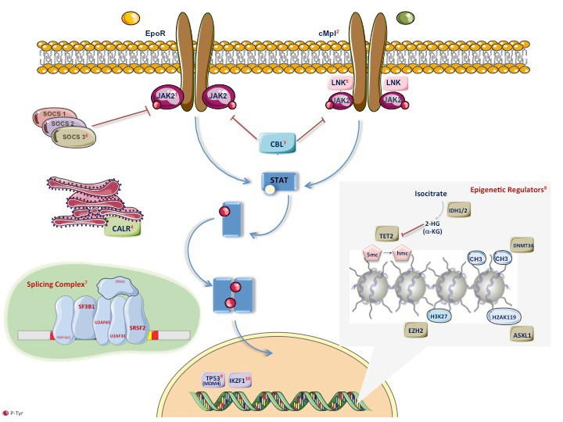
MPNs are much more complex than anticipated
Notes:
Please try to improve

Slide 5
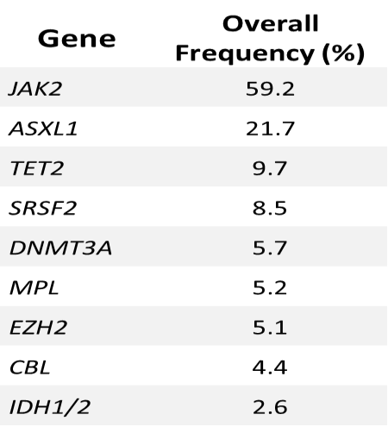
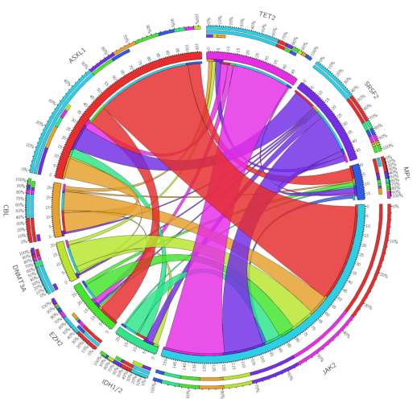
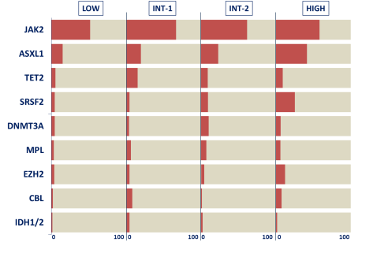
Mutational Profile
382 (79.1%) of patients presented at least one somatic mutation
154 pts (32.5%) had >2 mutations
31 pts (6.4%) had >3 mutations

Slide 6
“Driver Mutations” in MPNs affecting
JAK-STAT pathway
Klampfl et al., NEJM; Dec 19, 2013

Slide 7
Mutations in epigenetic regulators and spliceosome genes
Gene | Chromosome location | PV (%) | ET (%) | MF (%) | Blast phase (%)
TET2 | 4q24 | 10-16 | 4-5 | 7-17 | 17-32
IDH1/2 | 2q33.3 / 15q26.1 | 2 | 1 | 4 | 9-22
DNMT3A | 2p23 | 3-7 | <1 | 2-15 | 14-17
EZH2 | 7q36.1 | 3 | <1 | 7-13 | ---
ASXL1 | 20q11.1 | 2-7 | 0-3 | 13-32 | 18-33
SRSF2 | 17q25.1 | --- | --- | ≈15% | ≈20%
SF3B1 | 2q33.1 | --- | --- | 7% | ---
CBL | 11q23.3 | rare | rare | 6% | ---
TP53 | 17p13.1 | --- | --- | 4% | 27%
U2AF1 | 21q22.3 | --- | --- | 16% | ---
Also found in other malignances (MDS, AML)
Therefore, they are of no specific diagnostic value but indicate a myeloid malignancy
Vainchenker W et al, Blood. 2011; 18;118(7):1723-35; Vannucchi AM et al, Leukemia 2013; 27:1861-9.
Notes:
Need fixing to optimize color and look

Slide 8
New Initiative at Princess Margaret towards Personalized Cancer Care
AGILE – Advanced Genomics in Leukemia

Slide 9
Advanced Genomics in Leukemia (AGILE)
- variants detected in MPN cohort
NGS profiling of newly diagnosed AML, MDS and MPN patients, recruited through weekly leukemia clinics
N = 70 variants, 29 cases

Slide 10
AGILE Variant Landscape – by malignancy

Slide 11
AGILE variant load per case - by disease type
AML
MPN
3.18 variants/case
3.46 variants/positive case
2.34 variants/case
2.34 variants/positive case

Slide 12
How do we apply our evolving understanding in genomics in routine clinical care?

Slide 13
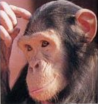
Ever-growing prognostic scores for MF
- what should I use?
  Lille score
  International Prognostic
  Scoring system (IPSS)
  Dynamic IPSS (DIPSS)
  DIPSS plus
  MIPSS

Slide 14
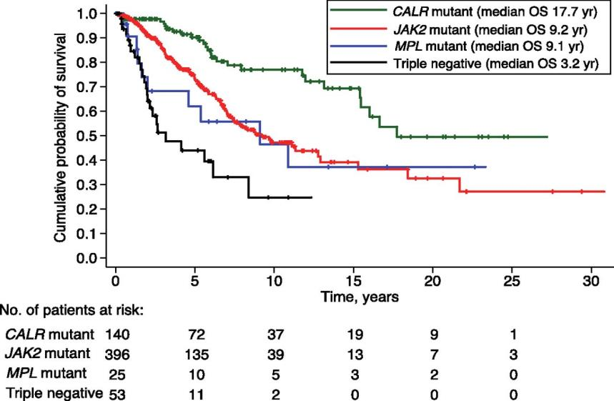
Impact of driver mutations on survival of PMF
Rumi E et al., Blood 2014;124:1062-1069

Slide 15
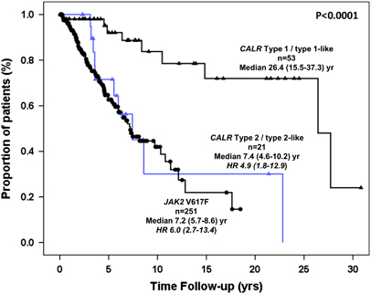
Impact of CALR type 1 vs type 2 mutations on survival of PMF
Compared to JAKV617F mutation:
CALR type 1 mutation:
  ↑ median OS
  CALR type 2 mutation:
    No difference in OS
CALR type 1 = 52-bp deletion
CALR type 2 = 5-bp TTGTC insertion
Guglielmelli et al., Blood Cancer Journal 2015;5

Slide 16
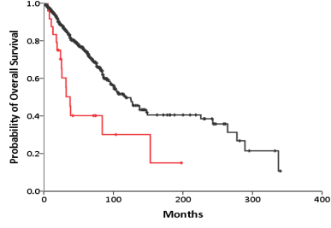
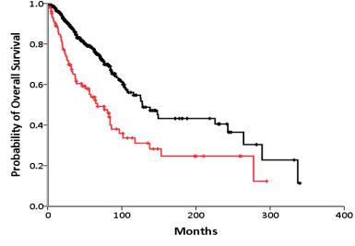
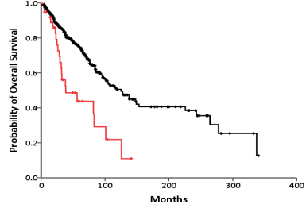
Mutations associated with reduced overall survival
EZH2
ASXL1
P= 0.0008
P< 0.0001
SRSF2
 | Hazard Risk (95% CI range) | P
EZH2 | 1.91 (1.08-3.36) | 0.025
ASXL1 | 2.21 (1.57-3.11) | <0.0001
SRSF2 | 2.60 (1.63-41.6) | <0.0001
P< 0.0001

Slide 17
Therapeutic options available to patients with myelofibrosis
Transplant options
  Myeloablative
  Reduced-intensity
Non-transplant options
  Conventional
  Treatment for anemia
    Transfusion support
    Erythropoietin
    Corticosteriods
    Androgen + prednisone
    IMiDs
  Treatment for splenomegaly
    Hydroxyurea
    Splenectomy
    Low-dose irradiation
  First approved medication
    Ruxolitinib
Experimental drug therapy
Pomalidomide
Novel JAK inhibitors
Others
  Hypomethylating agents
  HIDAC inhibitors
  mTOR inhibitors
Abbreviations: HIDAC, histone deacetylase; IMiD, immunomodulatory drug; JAK, Janus kinase; mTOR, mammalian target of rapamycin.

Slide 18
Transplantation for myelofibrosis
Potentially curative option
Can have high risk of significant complications
Optimal timing of transplant can be complex decision
Option for transplant in every MF patients in the transplant age group should be considered.
  Early vs. delayed vs. never

Slide 19
Who are the candidates for transplantation for myelofibrosis in 2015?
When is transplant an appropriate option?
  DIPSS - Intermediate-2/ high-risk
  ? DIPSS - Intermediate – 1
    High risk cytogenetics
    Severely cytopenic patients
      Transfusion dependent (non-responders to conservative options)
      Severe thrombocytopenia
      ?? High-risk mutations (ASLX1+ patients, ≥3 somatic mutations)

Slide 20
Selection of upfront therapy for patients with myelofibrosis
Patient Factors
NO
Advanced age
Poor performance status
Prohibitive co-morbidities
YES
NO
YES
Benefits
Curative Potential
NO
Benefits
Usually well-tolerated
QOL
YES
Disease Factors
NO
Severe complications
of MF such as
portal hypertension
High-risk of
leukemic transformation
JAK inhibitor therapy/
clinical trial
HCT
YES
YES
NO
Risks
  Risk of early mortality
  QOL
      GvHD
      Recurrent infections
Risks
  Unknown long-term effects
    Duration of response
    Possible resistance
  ? Impact of drug-induced cytopenias on survival / LT
Transplant Factors
YES
Well-matched donor
NO
HCT, hematopoietic cell transplantation; GvHD, graft versus host disease; JAK, Janus kinase; LT, leukemic transformation; MF, myelofibrosis; QOL, quality of life.
Gupta V, et al. Blood 2012;120:1367-1379.

Slide 21
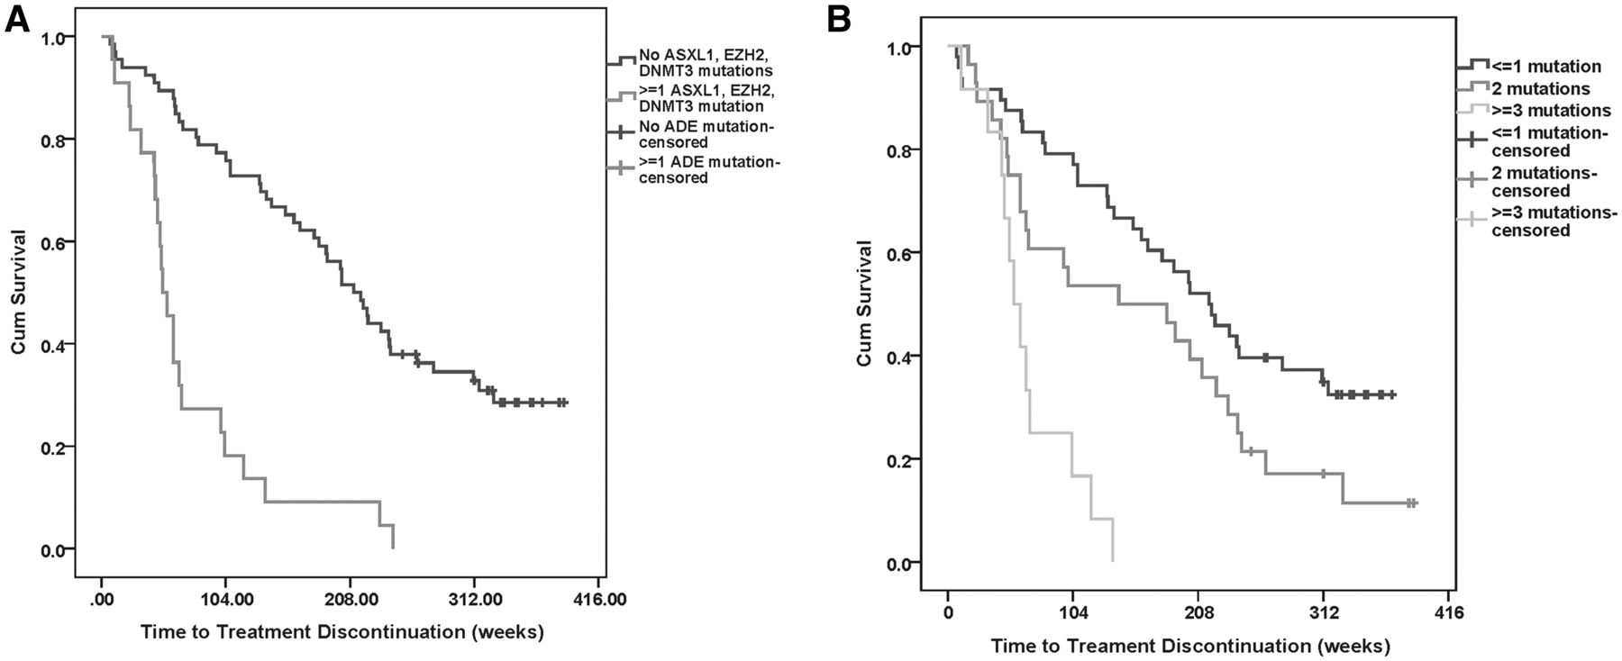
Mutations and response to Ruxolitinib
Spleen response (≥50% reduction in palpable spleen size) was inversely correlated with the number of mutations.
  Patients with ≤2 mutations had nine-fold higher odds of a spleen response than those with ≥3 mutations
Patients with ≥3 mutations had a shorter time to treatment discontinuation and shorter overall survival than those with fewer mutations
Patel et al., Blood 2015;126:790-797
Notes:
Need fixing to optimize color and look

Slide 22
Outcomes of HCT in Myelofibrosis (CIBMTR data)
100
100
90
90
80
80
70
70
60
HLA-identical sibling/Other related
60
Estimated Probability, %
50
50
40
Well-matched URD
40
30
30
Partially or mis-matched URD
20
20
10
10
0
0
0
20
40
60
80
100
120
140
Months
Cohort: 12% low-, 49% intermediate-1, 37% intermediate-2, and 1% high-risk MF patients
CIBMTR, Center for International Blood and Marrow Transplant Research; HLA, human leukocyte antigen; URD, unrelated donor.
Gupta V, et al. BBMT, 2014 ;20:89-97.

Slide 23
Therapeutic options available to
patients with myelofibrosis
Transplant options
  Myeloablative
  Reduced-intensity
Non-transplant options
  Conventional
  Treatment for anemia
    Transfusion support
    Erythropoietin
    Corticosteriods
    Androgen + prednisone
    IMiDs
  Treatment for splenomegaly
    Hydroxyurea
    Splenectomy
    Low-dose irradiation
  First approved medication
    Ruxolitinib
Experimental drug therapy
Pomalidomide
Novel JAK inhibitors
Others
  Hypomethylating agents
  HIDAC inhibitors
  mTOR inhibitors
Abbreviations: HIDAC, histone deacetylase; IMiD, immunomodulatory drug; JAK, Janus kinase; mTOR, mammalian target of rapamycin.

Slide 24
Phase III trials With Ruxolitinib:
Study Designs
Ruxolitinib
15 mg BID or 20 mg BID
N = 155
COMFORT-I¹
Double-blind
Randomized
Patients with MF
(N = 309)
Crossover to Ruxolitinib
1:1
Placebo BID
N = 154
Ruxolitinib
15 mg BID or 20 mg BID
N = 146
COMFORT-II²
Open-label
Randomized
Patients with progressive disease eligible for crossover
Patients with MF
(N = 219)
2:1
BAT
N = 73
The primary endpoint: ≥35% reduction in spleen volume from baseline to week 24 (COMFORT-I) or week 48 (COMFORT-II), as measured by MRI or CT
Abbreviations: BAT, best available therapy; BID, twice daily; COMFORT, Controlled Myelofibrosis Study with Oral JAK Inhibitor Treatment; CT, computed tomography; MF, myelofibrosis; MRI, magnetic resonance imaging.
1. Verstovsek S, et al., N Engl J Med. 2012;366:799-807; 2. Harrison CN, et al., N Engl J Med. 2012;366:787-798.

Slide 25
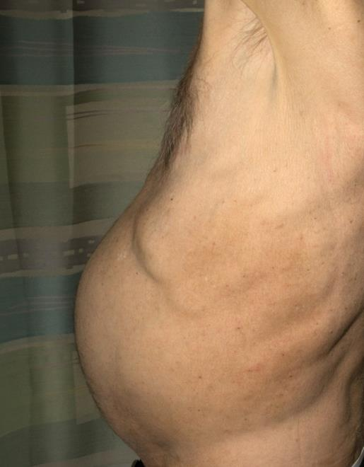
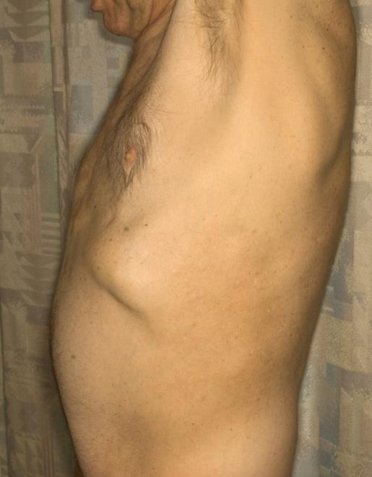
Spleen size reduction in patient treated with Ruxolitinib
Myelofibrosis patient pre-therapy
Patient after 2 months of therapy
Photos Courtesy of Serge Verstovsek, M. D. Anderson Cancer Center.

Slide 26
Limitations of Ruxolitinib
  Disease persistence
  Limited anti-clonal activity
  Lack of improvement or worsening of cytopenias
  Atypical infections
    Mycobacterial, hepatitis reactivation etc
  Does not decrease the risk of LT
  Rates of discontinuation
    @1 year, 21%; @2 year, 35%; @3 year, 51%

Slide 27
What is beyond Ruxolitinib?
Novel JAK inhibitors with better toxicity/efficacy
Ruxolitinib plus
  Conventional medications
  Novel agents
  Transplant
Novel non-JAK inhibitor drugs

Slide 28
JAK inhibitors in development in MF
Clinical Phase of Testing

Slide 29
Momelotinib (CYT 387)
JAK1/JAK2 inhibitor
  2 phase studies in various dose schedules done
    (Pardanani et al., ASH 2013. Abstract 108)
    (Gupta et al., EHA abstract 2014)
  Benefit seen in reduction of MF disease burden
    Reduction in splenomegaly
    Improvement in MF related symptoms
  However, lesser anemia toxicity
  Some patients achieved transfusion independence

Slide 30
Phase III studies with Momelotinib for myelofibrosis
Momelotinib + placebo
JAK inhibitor naïve
Randomized, Double Blind
Primary endpoint: Spleen Response by MRI at week 24
N = 420
1:1 randomization
Ruxolitinib + placebo
Day 1
Week 24
Year 5
Previous JAK inhibitor exposure
Randomized, Open Label
Required ruxolitinib dose adjustment to < 20mg BID and concurrent hematologic toxicity
Primary endpoint: Spleen Response by MRI at week 24
Momelotinib
N = 100
N = 150
2:1 randomization
Best Available Therapy (ruxolitinib and no treatment allowed)
N = 50
Day 1
Week 24
Year 5

Slide 31
Combination therapies with Ruxolitinib
(*various presentations ASH 2014)
Combine with Agents which may ameliorate anemia toxicity
  Ruxolitinib + Danazol*
  Ruxolitinib + EPO
  Ruxolitinib + IMiDs* (Thalidomide,Revlimid,Pomolidomide)
Drugs with Novel Mechanisms
  Panabinostat* (DAC #)
  Hypomethylating agents
  BKM 120* (PI3Kinase pathway)
  Sonidegib* (Smo#, HH signaling pathway)
  Triple combo (Rux + PIM447 + CDK4/6 #)

Slide 32
Novel drugs other than JAK inhibitors
Imetelstat
PRM-151
SL-401 (Diptheria toxin IL-3 fusion protein against CD123)

Slide 33
Clinical Trials at Princess Margaret
- JAK inhibitor therapy Naïve patients
A phase 3, randomized, double-blind, active-controlled study evaluating momelotinib vs. ruxolitinib in subjects with primary myelofibrosis (PMF) or post-polycythemia vera or post-essential thrombocythemia myelofibrosis (Post-PV/ET MF) [Gilead Protocol No.: GS-US-352-0101; NCT01969838]
Notes:
HOLD: A phase 2, open-label, prospective study of PRM-151 in subjects with primary myelofibrosis (PMF), post-polycythemia vera MF (post-PV MF), or post-essential thrombocythemia MF (post-ET MF) [Promedior Protocol No.: PRM-151G-101] [Gupta / Leblanc / Ramanna]

Slide 34
Clinical Trials
– Sub-optimal response to Ruxolitinib
A phase Ib, multi-center, open-label, dose-escalation study of PIM447 in combination with ruxolitinib (INC424) and LEE011 administered orally in patients with myelofibrosis [Protocol No.: CPIM447X2104C; NCT02370706]
A randomized controlled phase 3 study of oral pacritinib versus best available therapy in patients with thrombocytopenia and primary myelofibrosis, post polycythemia vera myelofibrosis or post-essential thrombocythemia myelofibrosis-PAC326 [Protocol No.: PERSIST-2 ; NCT02055781]
A phase 3, randomized study to evaluate the efficacy of momelotinib versus best available therapy in anemic or thrombocytopenic subjects with primary myelofibrosis, post-polycythema vera myelofibrosis, or post-essential thrombocythemia myelofibrosis who were treated with ruxolitinib [Protocol No.: GS-US-352-1214: NCT02101268]

Slide 35
Clinical Trials at Princess Margaret
- Transplant
Exploring the potential of dual kinase JAK 1/2 inhibitor ruxolitinib (INC424) with reduced intensity allogeneic hematopoietic cell transplantation in patients with myelofibrosis (Protocol No. MPD-RC 114; NCT01790295)
Notes:
HOLD:
A phase 2, open-label, prospective study of PRM-151 in subjects with primary myelofibrosis (PMF), post-polycythemia vera MF (post-PV MF), or post-essential thrombocythemia MF (post-ET MF) [Promedior Protocol No.: PRM-151G-101] [Gupta / Leblanc / Ramanna]

Slide 36
Shared Care Model for MPN at the Princess Margaret

Slide 37
How do we envision improving care of MPN patients?
Major issues with MPN care in Canada
  Fragmented care
  Limited expertise outside major centers
Model of care for MPN patients at Princess Margaret
  Consolidate the care without putting extra burden on UHN system
  Improved care, value and efficiency
  Address the educational needs
    Build expertise of other HCPs within UHN, referral base and nationwide

Slide 38
How do we envision improving care of MPN patients?
  How do we plan to deliver this?
  Work on “Hub and Spoke” model
    Access to expert advice
    Management plan at diagnosis with regular periodic reviews
    Access to complex therapeutic decision making e.g. transplant
    Access to novel drugs through clinical trials for patients failing standard therapies
  Regular care to be provided near to home by local hematologist /oncologist/internist/FP
    Transfusion support
    Standard or approved therapies
    Management of other associated medical conditions

Slide 39
“Shared care model” for MPN patients
Resources for success of shared care model
  Two way flow of information between MPN physician at PMH and community care provider
    New technologies shared between PM and referring physicians
    MPN coordinator/MPN physicians at PMH
      Teaching program
        Patients and families
        Teaching of Health Care Professionals
            Build comfort level in dealing with the rare diseases
            Social media strategy

Slide 40
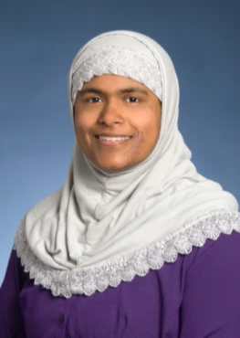
Facilitator for Shared Care Model
Clinical Nurse Specialist/MPN Program Coordinator
Former staff nurse, clinical educator and team leader at Sunnybrook, 15 years.
2014: Joined Princess Margaret as Allogeneic Stem Cell Transplant Coordinator.
2015: Transitioned to Outreach Coordinator, Leukemia program
Clinical Nurse Specialist responsibilities will include:
  Assisting with diagnosing patients
  Providing and educating patients on their individualized care plans

Slide 41
Potential Opportunities for PMH and KGH to Work together
Shared care referrals
  Newly diagnosed patients
    MF
    PV/ET who have failed HU
    Other rare MPNs
    Patients suitable for Clinical trials and able to commute
    Difficult scenarios in clinical management
  Value added services
    Genomic profiling
    Develop a management plan in collaboration with Kingston team

Slide 42
Potential Opportunities for PMH and KGH to Work together
Training for HCPs
  Fellowship opportunities
    Dedicated MPN fellowship launched from 1 Jan 2016
  Training of hematology residents
    4 week block dedicated to MPN and other chronic myeloid malignancies
      Variety of cases in a busy clinic environment
      Facilitates training in a rare disease area
  Training of Support Staff
    For Nursing staff – a dedicated MPN clinic day to be launched from March 2016

Slide 43
Conclusions
The field of MPN is rapidly advancing with better understandings of genetics and underlying patho-biological mechanisms.
Ruxolitinib is the first approved therapy for MF, and future of research shifts to novel agents with better toxicity profile or novel agents added to JAK inhibitor therapy.
New models for care delivery with further enhance the improvement in care and outcomes of MPN patients

Slide 44




Acknowledgements
Leukemia / BMT Programs at PMH
Andre Schuh
Mark Minden
Karen Yee
Aaron Schimmer
Jeff Lipton
Hans Messner
Dennis Kim
Auro Viswabandya
Laboratory Medicine Program
Hubert Tsui
Anna Porwit
Suzanne Kamel-Reid
Emina Torlakovic
Major International collaborators
Ruben Mesa, Scottsdale
Srdan Verstovsek, Houston
Jason Gotlib, Stanford
Ross Levine, NYC
Claire Harrison, London
OICR – Scientific Collaborations
John Dick
Liran Shlush
Mark Minden
MPD-RC
Ron Hoffman, NYC
John Mascarehans, NYC
And many Others
CIBMTR
Dan Weisdorf, MN
Martin Tallman, NY
And many others
Canadian MPN Group
Lynda Foltz, Vancouver
Shireen Sirhan, Montreal
Lambert Busque, Montreal
Robert Turner, Edmonton
Jeff Prchal, Montreal
Brian Leber, Hamilton

Slide 45

THANK YOU!
Any Questions?
45
Notes:
45

