Slide 1

Which Myelofibrosis Patients are Candidates for Upfront Stem Cell Transplantation?
Vikas Gupta, MD, FRCP, FRCPath
The Elizabeth and Tony Comper MPN Program
Princess Margaret Cancer Centre
University of Toronto
Toronto, Canada

Slide 2
Disclosures
Vikas Gupta, MD, FRCP, FRCPath
Research support/P.I. | Novartis, Incyte
Employee | None
Consultant | Novartis,
Major Stockholder | None
Scientific Advisory Board | Incyte, Novartis
Notes:
COI slide

Slide 3
Who are the candidates for transplantation for Myelofibrosis in 2015?
Patients in the transplant age group
  Usually <70 yrs. old, reasonable performance status and no prohibitive co-morbidities
MF related features
  DIPSS - Intermediate-2/ high-risk
  ? DIPSS - Intermediate – 1
    High risk cytogenetics
    Severely cytopenic patients
      Transfusion dependent (non-responders to conservative options)
      Severe thrombocytopenia
      ?? High-risk mutations (ASLX1+ patients, ≥3 somatic mutations)

Slide 4
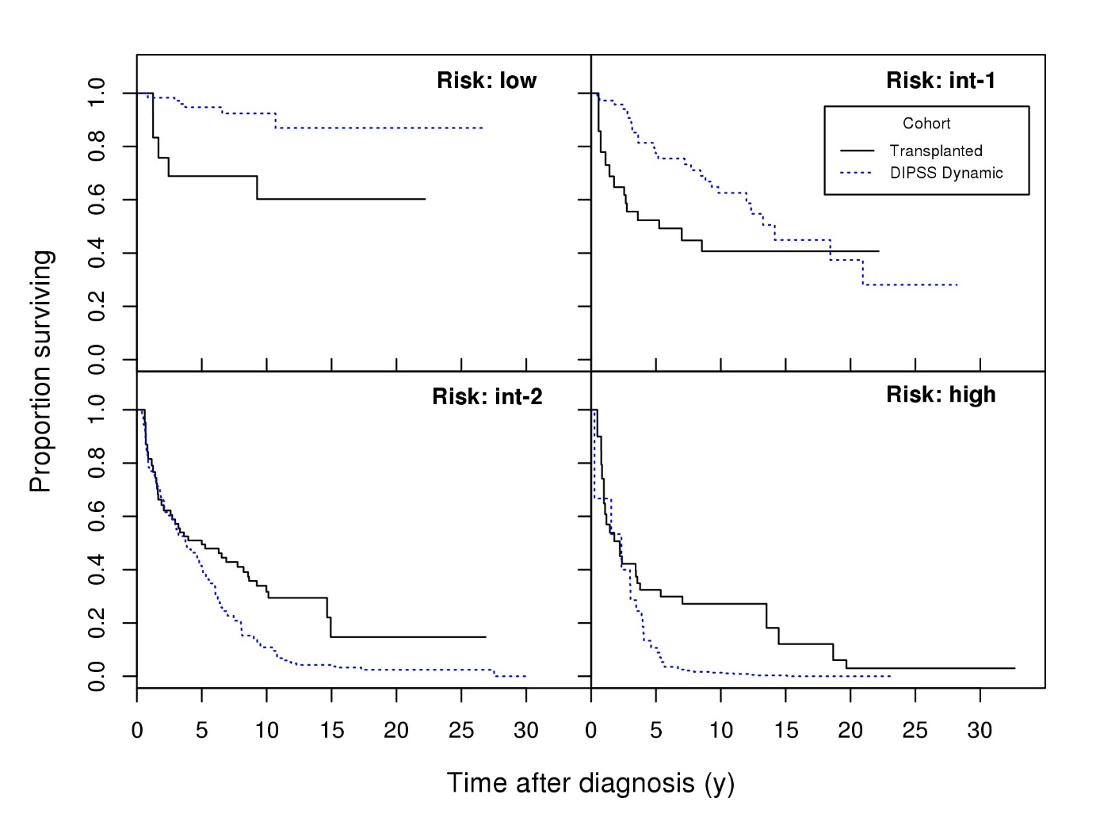
Comparison of HCT vs non–transplant
according to DIPSS in pts. <65 years
p= 0.002
p= 0.2
p= 0.005
p=0.0005
HCT, hematopoietic cell transplantation; DIPSS, dynamic international prognostic scoring system
Kroger et al. Blood 2015

Slide 5
Case Study
61 yrs. F
  Symptoms of fatigue, frequent night sweats, and weight loss
  Examination – palpable spleen length 18 cms.
  Hb 92 g/L, WBC 29.6 x 10⁹/L, ANC 26.1 x 10⁹/L, platelets 287 x 10⁹/L, PB blasts 1.5%
  Diagnosed with JAK2V617F positive PMF
  Cytogenetics – 46, XX, no clonal abnormalities

Slide 6
Case Study
DIPSS risk score 5 (High-risk)
No available siblings
Started on Ruxolitinib 20 mg BID
2 months later
  Significant improvement in symptoms
  Spleen palpable by 10 cms (previously 18 cms)
  Good performance status, and QOL
  CBC – Hb 83 g/L; WBC 16.0 x 10⁹/L; platelets 112 x 10⁹/L, blasts 2%
  Donor search – 10/10 Matched URD
URD, unrelated donor

Slide 7
What would be your treatment preference in this patient?
Proceed with URD transplantation at the peak of response to therapy
Delay the transplant for now, reconsider if patient looses response to JAK # therapy or becomes intolerant
Allotransplant is “attempted SUICIDE”!! NEVER
Not sure

Slide 8
Selection of upfront therapy for patients with Myelofibrosis
Patient Factors
NO
Advanced age
Poor performance status
Prohibitive co-morbidities
YES
NO
YES
Benefits
Curative Potential
NO
Benefits
Usually well-tolerated
QOL
YES
Disease Factors
NO
Severe complications
of MF such as
portal hypertension
High-risk of
leukemic transformation
JAK inhibitor therapy/
clinical trial
HCT
YES
YES
NO
Risks
  Risk of early mortality
  QOL
      GvHD
      Recurrent infections
Risks
  Unknown long-term effects
    Duration of response
    Possible resistance
  ? Impact of drug-induced cytopenias on survival / LT
Transplant Factors
YES
Well-matched donor
NO
HCT, hematopoietic cell transplantation; GvHD, graft versus host disease; JAK, Janus kinase; LT, leukemic transformation; MF, myelofibrosis; QOL, quality of life.
Gupta V, et al. Blood 2012;120:1367-1379.

Slide 9
Outcomes of HCT in Myelofibrosis (CIBMTR data)
100
100
90
90
80
80
70
70
60
HLA-identical sibling/Other related
60
Estimated Probability, %
50
50
40
Well-matched URD
40
30
30
Partially or mis-matched URD
20
20
10
10
0
0
0
20
40
60
80
100
120
140
Months
Cohort: 12% low-, 49% intermediate-1, 37% intermediate-2, and 1% high-risk MF patients
Gupta V, et al. BBMT, 2014 ;20:89-97.
CIBMTR, Center for International Blood and Marrow Transplant Research; HLA, human leukocyte antigen; URD, unrelated donor.

Slide 10
Various time points of using HCT in the management of Myelofibrosis
Option#1. Clinical Improvement or stable disease on JAK inhibitor therapy
Option#2. Delay the HCT as long as benefiting from JAK inhibitor therapy, and consider HCT if
  Intolerant to JAK inhibitors due to toxicities
  Worsening of anemia transfusion dependence or Increased blast count (10-19%)
  Sub-optimal/loss of response requiring change in therapy
Option#3. Progressed to leukemic transformation
HCT, hematopoietic cell transplantation
Adapted from Shavanas & Gupta, Best Pract Res Clin Haematol. 2014; 27:165-74.

Slide 11
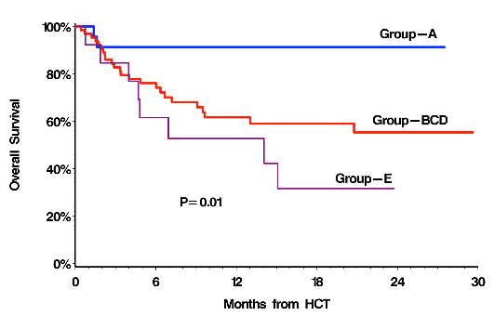
Outcomes of HCT in MF according to response to JAK inhibitor therapy (Shanavas et al, EHA, 2015)

Slide 12
Potential benefits of using JAK inhibitors in the transplant protocols
Graft failure?
  Bone marrow fibrosis – poor environment for the stem cell
  Significant Splenomegaly
  Cytokines?
GVHD?
  Decreased cytokine levels may reduce the risk of severe GVHD
TRM?
  Better performance status prior to HCT may yield improved outcomes
JAK-1/2 #
1.↓ Spleen Size
2.↑ QoL scores
3.↓ Cytokine levels (anti-JAK1 mediated)
→ Improve constitutional symptoms
GVHD, graft versus host disease; TRM, transplant-related mortality

Slide 13
JAK ALLO: Recruitment stopped after 22 patients enrolled due to unexpected SAEs in 3 patients
No. 1
RUXO: spleen ↓ 25%
FLU,MEL, ATG
G
APLASIA
ENGRAFTMENT
TLS
Gr 3-4
GVHD D+7
Death
5 months
No. 2
RUXO: spleen stable
One day FLU + ATG
G
Stable disease
Splenectomy
Cardio.
shock
Alive
11 months
No. 3
RUXO: spleen ↓ 25%
FLU,MEL, ATG
G
Progressive disease
Splenectomy
Cardio.
shock
Multiple
thromboses
Death
7 months
Robin M, et al. ASH Annual Meeting. New Orleans, Louisiana; December 7-10, 2013. Abstract 306.
13
Notes:
JAK allo

Slide 14
Current published experience of combined approach of JAK inhibitors in transplant protocols
Study | No | Study Design | Results | Conclusions
Jaekel et al BMT 2014 | 14 | Retrospective | GF, 1/14 Treatment related sepsis, 1/14 | Tapering Rux. until conditioning did not result in unexpected SAE
Shanavas, et al, BMT 2014 | 6 | Retrospective | No adverse impact on early post HCT outcomes | As above
Stubig et al, Leukemia, 2014 | 22 | Retrospective | 1-year OS of 100% in those good resp. to Rux. vs. 60% others | Continuing Rux. until conditioning without taper – No unexpected SAEs
Lebon et al, ASH abstract 2013 | 11 | Retrospective | Good engraftment rates | Differing schedules of tapering
Jaekel N et al. BMT 2014;49:179-84.; Shanavas M et al. BMT 2014;49:1162-69.; Stubig T et al. Leukemia 2014;28:1736-38.; Lebon D et al. ASH 2013, abstract 2111

Slide 15
Symptoms observed during discontinuation of JAK# at HCT (Shanavas et al, EHA, 2015)
  All symptoms:10
    Return of MF related baseline symptoms: 6
    TLS:1, HA-1, Resp failure-2 (HCT delayed)
Patient | JAK# | Interval | Events | Outcome
F 64 PPV-MF | Rux 5m CI | 10 | Pulm-infiltrates, splenomegaly | HCT Rescheduled Alive 16 m
F 52 PPV-MF | Rux 16m SD | ≥7 | Fever, hypoxic resp failure | HCT Rescheduled. Recurrence 2ndtime. Died d+37 resp failure
Incidence: all patients (n=66): 15%
  JAK-HCT interval ≥6 days (n=20): 30%
  JAK-HCT interval <6 days (n=46): 9%
  p= 0.06
Notes:
Data from Shanavas

Slide 16
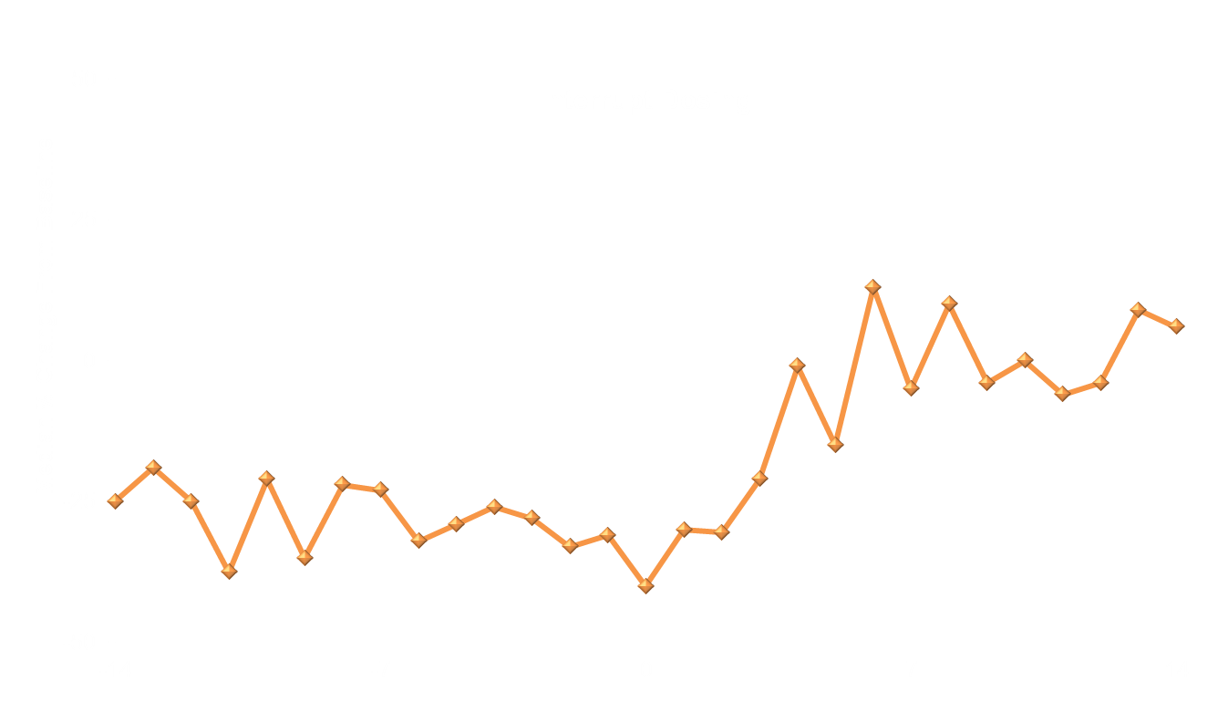
COMFORT-I: Total symptom score before and during interruption
Number of patients:
34
33
33
34
34
33
33
33
36
37
39
40
40
40
34
29
26
23
24
24
22
22
22
20
21
20
18
17
15
Days Around Dose Change
COMFORT, Controlled Myelofibrosis Study with Oral JAK Inhibitor Treatment.
Verstovsek S et al. Blood 2011;118:5146 (ASH 2011 abstract)

Slide 17
Conclusions
HCT is an appropriate option for selected patients with Myelofibrosis
  Int-2/high-risk disease
  Int-1 with transfusion dependency or unfavorable cytogenetics or (High-risk mutational signature)
The selection of patients should be individualized based on patient wishes and other patient-, disease-, and transplant-related factors
When used in the setting of transplant, JAK # therapy should be continued near to start of conditioning therapy
Continued enrolment in prospective studies is required to identify the optimal timing of HCT in MF patients.

Slide 18

THANK YOU!!
Any Questions?
18
Notes:
18

